Slide 1

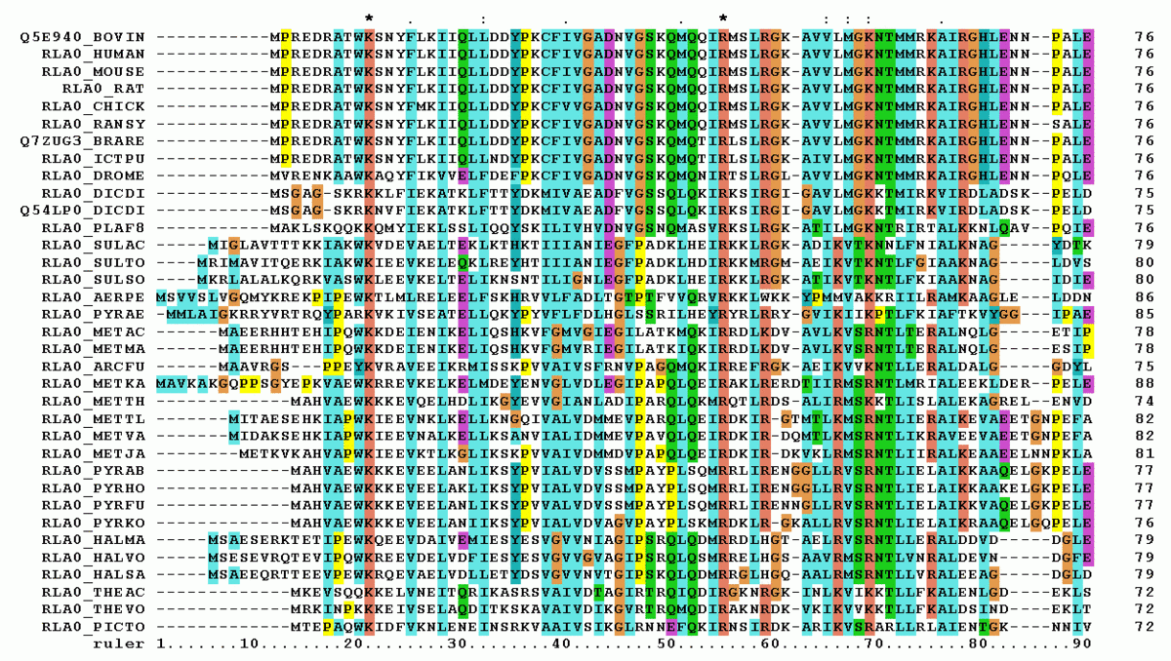
ML2223-15 Approve Prediction of Multisequence Learning
Prepared By Group 15:
Poonam Dashrath Paraskar(1427297)
Ankita Talande(1427349)
Pratik Desai

Slide 2
Index
Introduction
Methodology
Flow chart of Implementation
Results
Conclusion

Slide 3
Introduction
Multisequence learning is a machine learning approach in which a model learns temporal patterns of sequences one by one during the experiment and provides the matching sequences as the predicted output.
In this approach, a list of sequences with double data-type are stored in an excel file, which is used as the input sequence file for the model to train itself by storing these values in temporal memory.
The model then predicts the next element of the predicted sequence based on the patterns learned from the previous sequences.

Slide 4
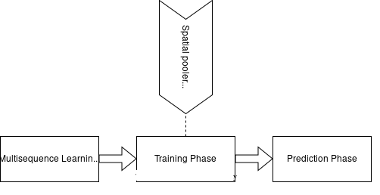
High Level Flow

Slide 5
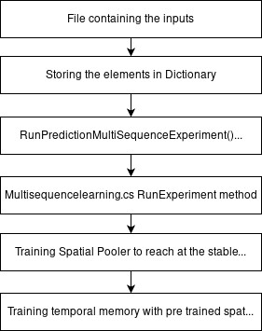
Methodology
The Multisequence Learning experiment executes in two phases:
Learning/Training Phase:
In learning phase input data sequences are getting passed to RunExperiment() method.
In RunExperiment() method training of input sequences is done using Cortex Layer, Spatial Pooler, Homeostatic Plasticity Controller which checks the stability of spatial pooler.
Training of input sequences is required to get the stable state of Spatial pooler. Newborn cycles are generated for each input sequence till the time Spatial pooler reach the stable state.

Slide 6
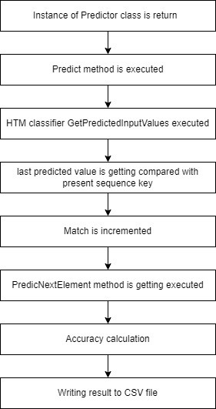
Methodology
2. Prediction and Accuracy Calculation phase:
PredictNextElement() method and Predictor class is used for prediction.
After the learning process, the algorithm returns the instance of Predictor class. This class provides Predict() method with a list of input elements.
For every presented input element, the predictor tries to predict the next element.
In PredictNextElement() method, team has added implemented below formula to calculate accuracy.
Accuracy = (count of matches/total number of predictions) * 100 %

Slide 7
Methodology
Team has implemented below methods and changes in existing application:
GetInputFromTextFile( )
GetInputFromCsvFile( )
GetInputFromExcelFile()
GetSubSequencesInputFromExcelFile( )
Accuracy Calculation and writing final accuracy in CSV file.
Encoder Settings updated for min-max value in the range of 0-99
Utilization of relative file path – In which Environment.CurrentDirectory property of C#, is used for providing input files to methods mentioned above.

Slide 8
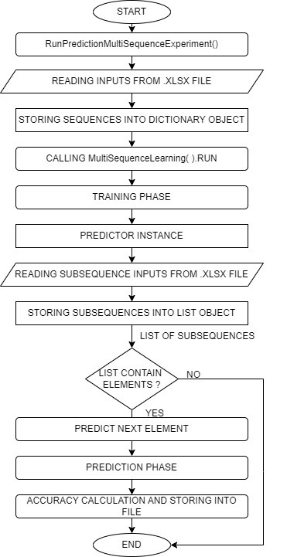
Flow chart of Implementation:

Slide 9
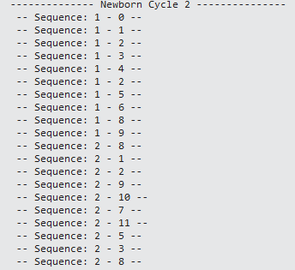
Results
We have divided our result into four sections:
Result of training phase:
Model is getting trained for each input sequence and newborn cycle gets generated till the spatial pooler reach the stable state. Result of training phase can be seen in below figure 1.1.
For each input sequence Spatial pooler learns the pattern and with pretrained spatial pooler and HPC, the temporal memory quickly learns cells of patterns.
figure 1.1. Training Phase

Slide 10
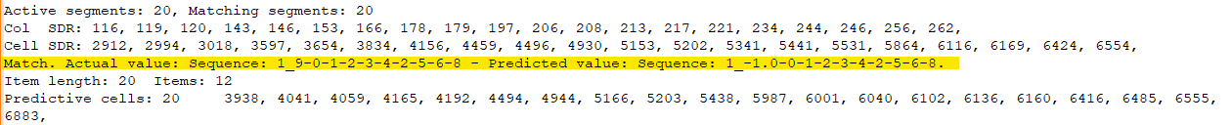
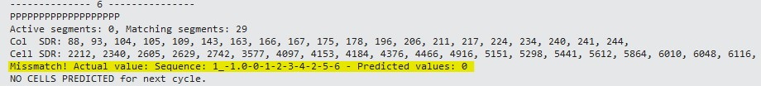
Results
2. Result of prediction phase:
Prediction phase is carried out once training phase is completed. Prediction phase executes in three steps match detection, mismatch detection and next element prediction.
Figure 1.2. Match Detection
Figure 1.3. Mismatch Detection

Slide 11
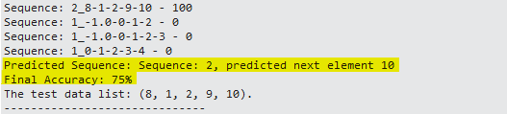
Results
3. Result of Accuracy Calculation Phase
Accuracy is calculated by dividing matches with total number of predictions multiply by 100.
Accuracy = count of matches / total number of predictions * 100
Count of match is a counter for each detected match this gets incremented. Figure 1.4 shows result of accuracy calculation
figure 1.4. Accuracy Calculation

Slide 12
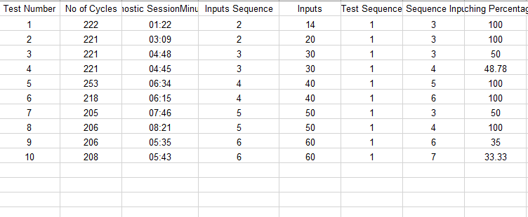
Results
4. Performance testing and comparison with legacy code:
In this phase of testing, we tested the code for 10 iterations with different range of training data and test data and compare the performance of newly implemented the code and legacy code.
The result of performance testing can be found here.
One of the result is attached below:

Slide 13
Conclusion
Team has developed new method that read learning sequences from a file by itself and learn them.
Different methods are created to predict the trained sequences by comparing the generated similarity matrix with each of the SDRs of the learned sequence from the training phase, and the accuracy percentage of the predicted sequences was calculated and stored in a file.
The accuracy of the predictions was found to increase with the number of cycles, indicating that the learning process improved over time.
Unit test cases can be added as a future scope.

